Slide 1
L17 Family Access Portal via AppConnect
July 2026

Slide 2

Introduction & Background
Who is this for?
This user guide is intended for all current external application end-users. It will demonstrate quick and secure access via AppConnect once your Multi Factor Authentication (MFA) is complete.
Access AppConnect →
https://myapps.forms.health.vic.gov.au/
  Why is this new portal needed?
  Digital Application Access
  DH and DFFH engage external partner organisations and health services to deliver services on behalf of the State, including shared digital applications that enable secure access to sensitive information.
  Improving Security
  Identity and Access Management (IDAM) is a critical control for protecting this data. DH and DFFH are strengthening this capability through improved tools.
  AppConnect, Single Sign-On & Multi-Factor Authentication
  External access will move to AppConnect, a modern identity and access management solution using Microsoft Entra ID, Single Sign On (SSO), and Multi Factor Authentication (MFA).

Slide 3
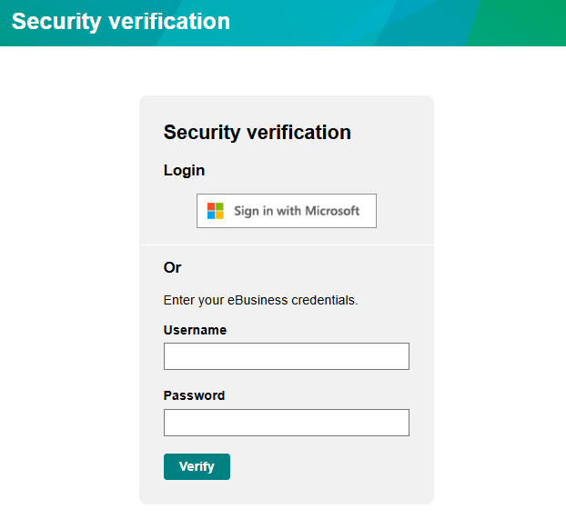
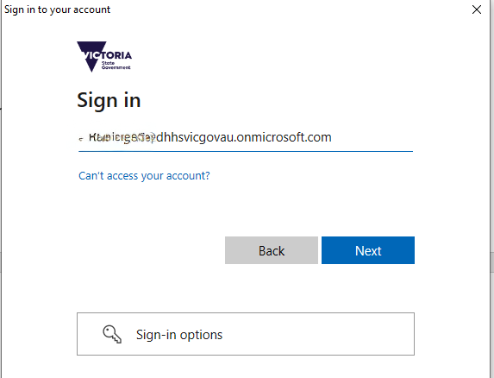
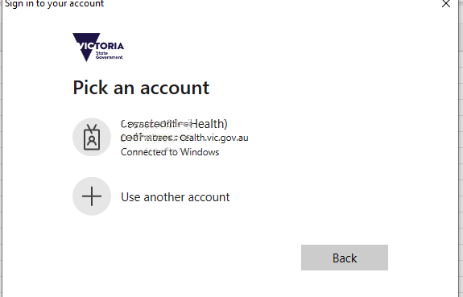
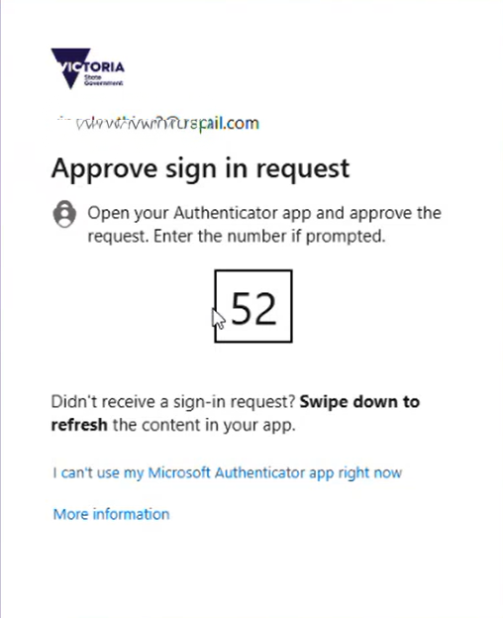
Option 1: Direct Login to the L17 FV Portal
L17/FVP
The L17 Family Violence Portal is now being migrated to the secure login via the L17/FVP URL:
https://fvpeb.ace.webapp.dhs.vic.gov.au/l17siebel/app/l17/enu?
Once instructed to do so, use the Sign in with Microsoft button. After migration is completed, a subsequent change will make the Microsoft sign in.
Accessing the L17 FV Portal
On the first login you may be requested to manually enter your email address.
Enter your Organisation’s email address and click Next. Do not use personal email accounts.
On subsequent logins, select the correct option under ‘Pick an account’.
Multi-factor Authentication
Whether you’ve set your MFA to send an SMS or use the MS Authenticator app, follow those steps to complete your login.
Note: Not all applications are being transitioned across to AppConnect at once. To see which applications you can access via AppConnect, please see the next page
**Note: Email addresses have been masked intentionally in these pictures.

Slide 4
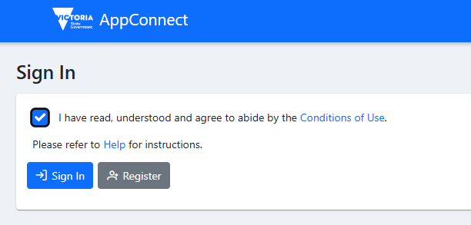
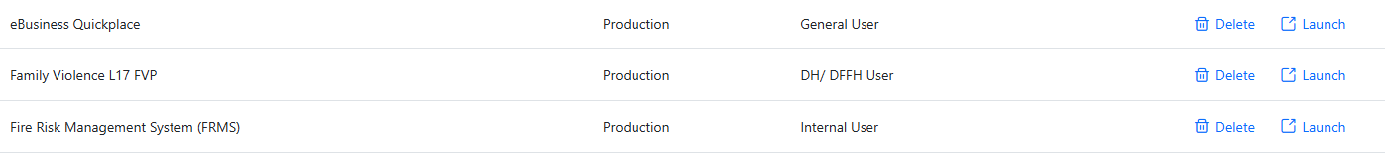
Option 2: Sign in via the AppConnect Portal
Signing in via the AppConnect Portal
The other option if you have several applications for DH or DFFH that you need to access, you can do this via the AppConnect portal that you get to from here:
https://myapps.forms.health.vic.gov.au/
Select Sign In
Examine the list of applications you have access to and select Launch for the Family Violence L17 Portal or any other application you need to use.
**Note: Email addresses have been masked intentionally in these pictures.

Slide 5
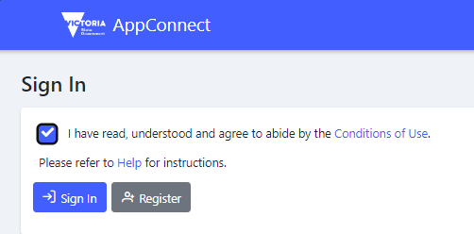
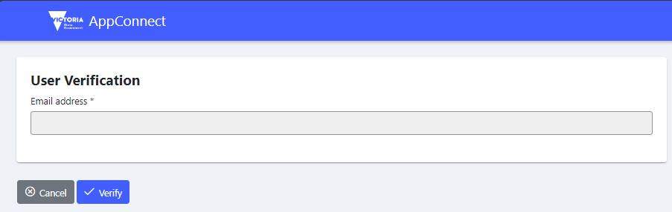
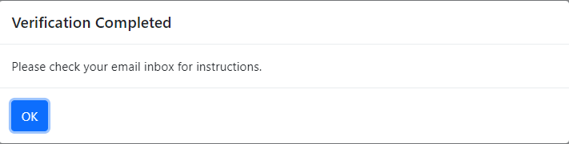
New User Self-Registration – User Verification
Once off – New User Registration
If you are asked by your Organisation Authority or Department staff to register for AppConnect, follow these steps before attempting to login.
NOTE: This is only required for users that haven’t previously accessed the system or been imported during a transition from e-Business
Click here to access AppConnect.
Conditions of Use Acceptance
Click the box to accept the “I have read , understood and agree to abide by the Conditions of Use”
Click on the Register button. User Verification page is displayed.
User Verification
It’s important here to register with your Organisation’s email address, not a personal email address
Once you’ve entered your email address, click Verify.
Complete Verification
Click OK and AppConnect will send an email to validate the email address. Check your email inbox for instructions.

