Slide 1
Look and Feel Changes
ICCMS Refresh Project
Presentation for Organisations using CRISSP
November 2023
OFFICIAL

Slide 2


New Icons
  New CRISSP (left) and CRIS (right) icons. From 27 November these are the icons that will appear when using eBiz or crisp.org.

Slide 3
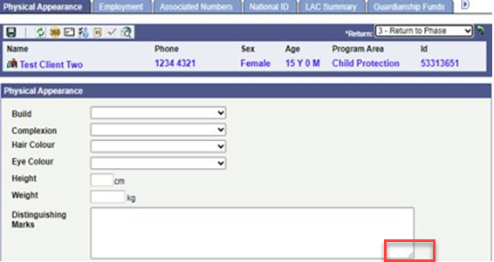
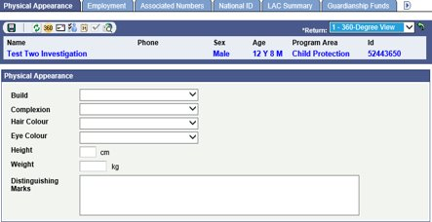
Expand Long Text Fields
The description field can now be made larger to view all text in the description, removing the need to scroll.
Select the corner of the text box by clicking the left mouse button and drag to the desired size.
No option to expand previously

Slide 4
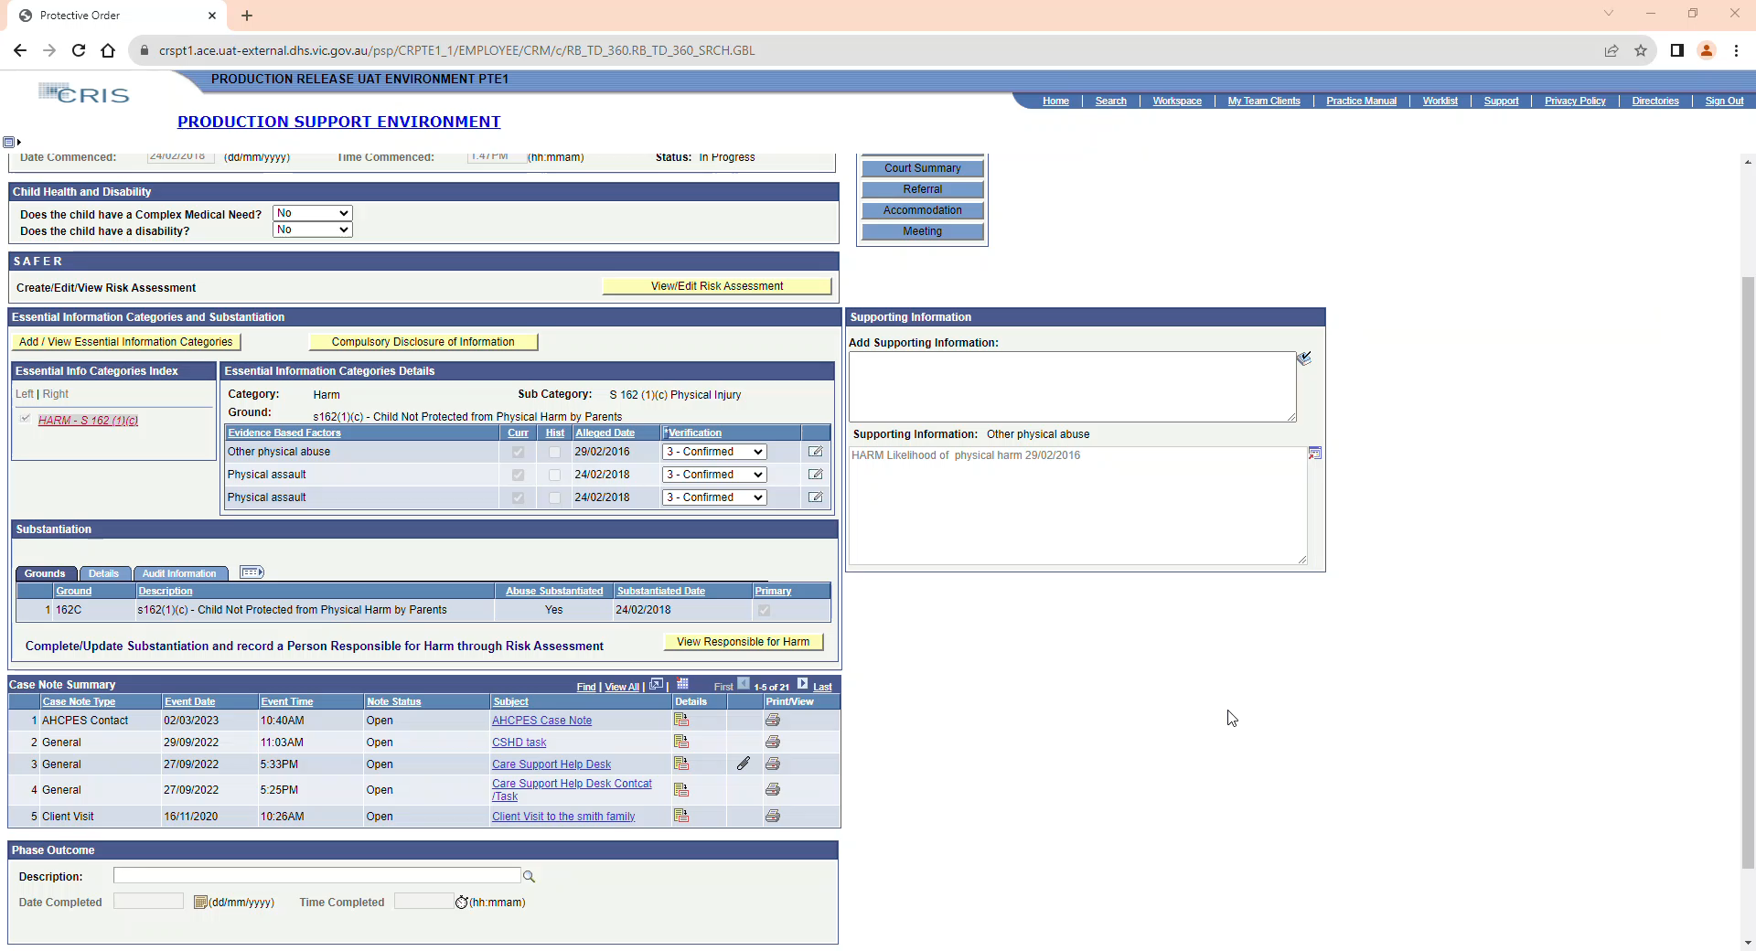
New Tabs, No More Pop-up Windows
Wherever a new pop-up window would open, this has been replaced by a new tab.
To exit close the tab, not the window as this will close the whole browser.
To create a new window, you can click and hold the new tab, then drag to a new location. The recording demonstrates this.

Slide 5
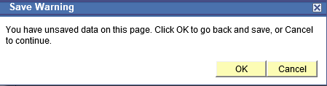
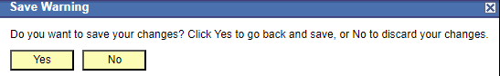
Save Warning Differences
The top warning is previous version, one underneath is post ICCMS Refresh.

Slide 6
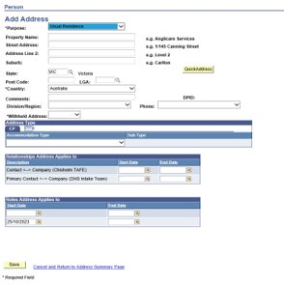
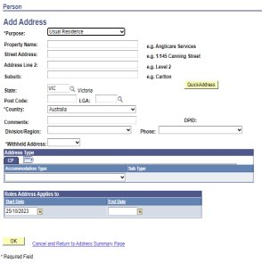
Save changed to OK
  Feature change also appears for in person – add phone and new pager & email.
  Before Refresh
  After Refresh

Slide 7
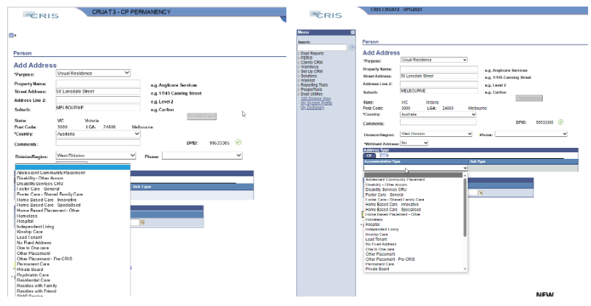
Scroll Selection Drop Downs
  Post refresh version has scroll feature within the dropdown list.

Slide 8
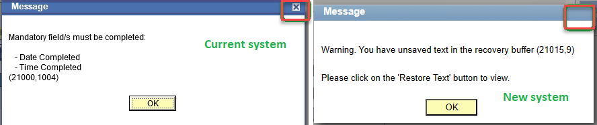
New system messages
  Will not have a close icon in the top right corner.

Slide 9
Push Buttons
  When the cursor highlights a particular page field, there will be a black border instead of dotted line as shown below.

Slide 10
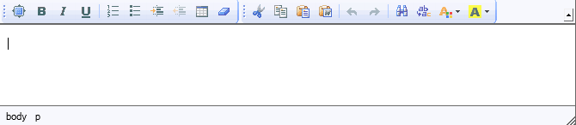
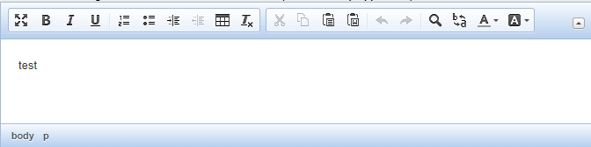
Text Formatting
Work around for missing functions
Spell check: as a work around, use default browser spell check
Highlighter: enabled the font colour and background options
Paste: users are prompted to use Ctrl+V

Slide 11
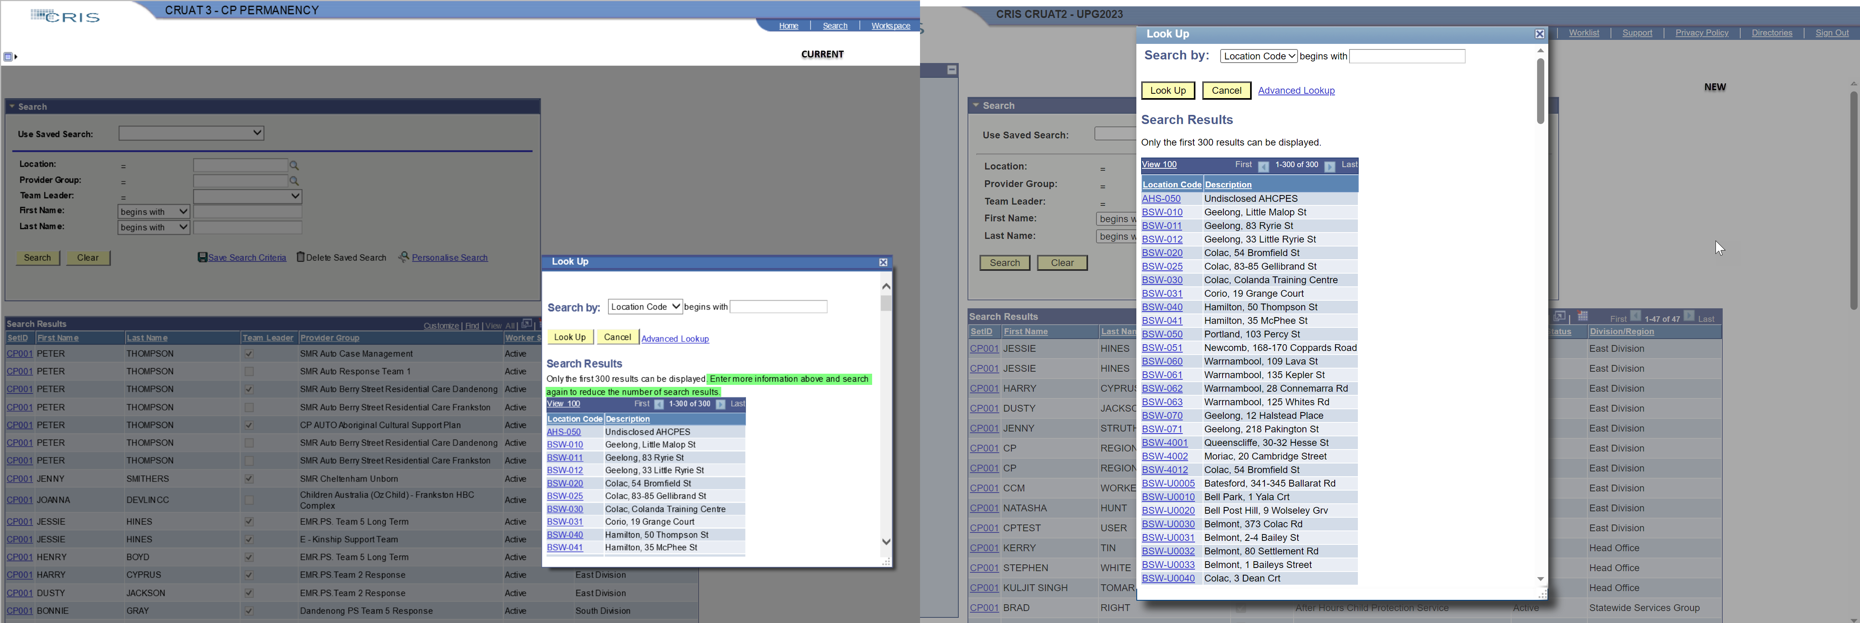
Look Up Search Results
Search results page will continue to show only top 300 results.
Use the Search by to filter down the results.

