Slide 1
Set Up Your Browser Post ICCMS Refresh
Instructions for Organisations that use CRISSP to set up their browsers
November 2023
OFFICIAL

Slide 2
Background
ICCMS is supported by aging technology that can no longer meet the performance expectations and the ongoing enhancements required to meet and respond to needs of the Victorian community.
To address this technology problem, CRISSP is receiving a technical update to ensure ongoing business and regulatory requirements are achieved, and the system remains stable, responsive and reliable for use by community services.
With the transition to this new platform, users will notice some modernisation of CRISSP features resulting in a new look and feel to some functions.
If you require further information about this upgrade, please email the ICCMS project team via clientsystemsupport.cris@dhhs.vic.gov.au

Slide 3
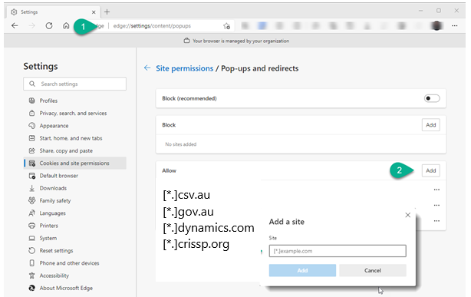
Allow Pop Ups
Type in URL/Address Bar edge://settings/content/popups
Select Add to allow sites to have pop-ups disabled. - The application uses modal windows which behave like pop-ups if they are blocked the application will not function as expected.
[*.]csv.au [*.]gov.au [*.]dynamics.com [*.]crissp.org

Slide 4
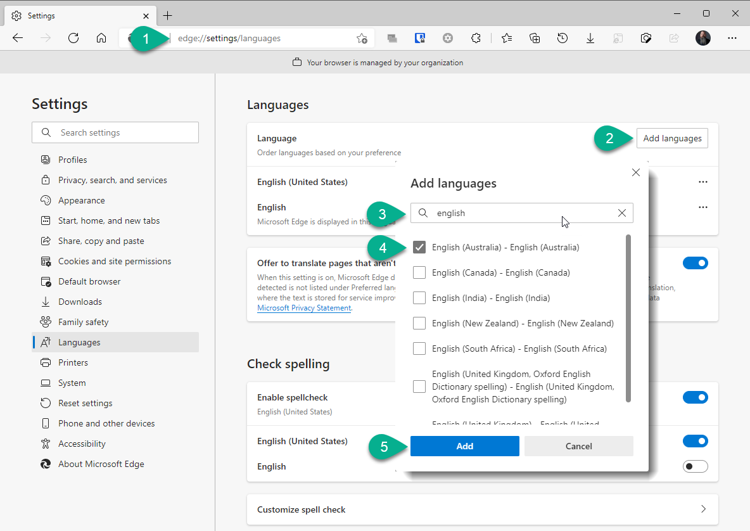
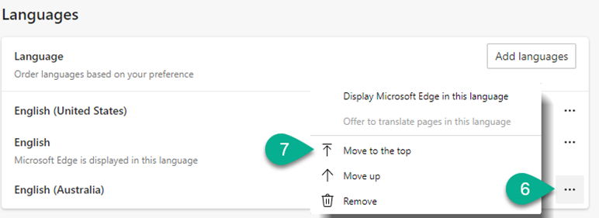
Language
Type in URL/Address edge://settings/languages
Select Add languages – The application requires language setting English Australia for calendar to function correctly.
Type English in the look-up/search field, select English Australia, select Add.
Select 3 dots next to English (Australia) and select Move to the top.

Slide 5
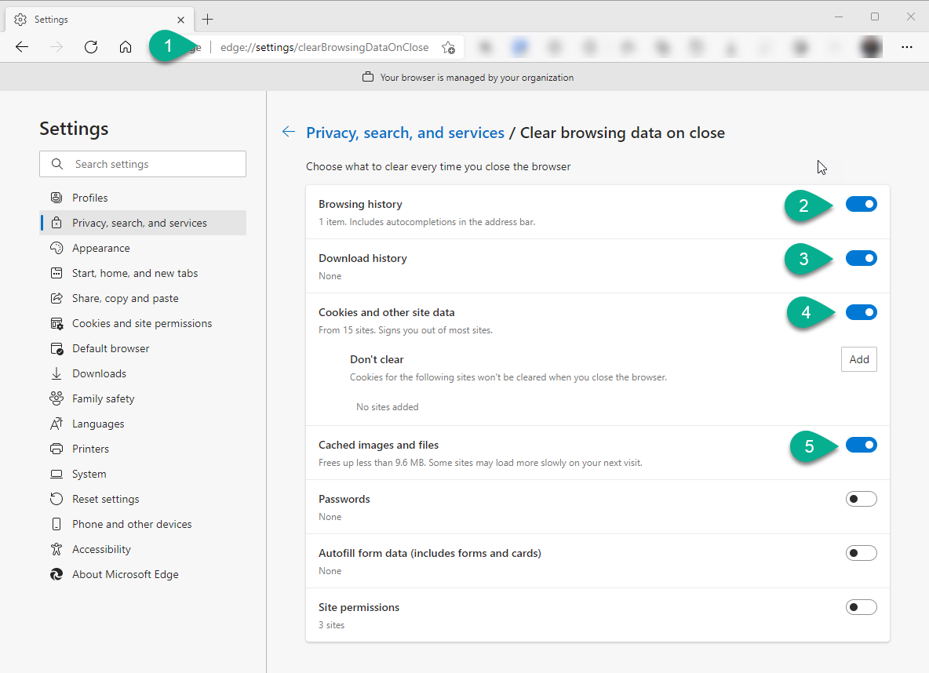
Clear Browsing Data
Type in URL/Address Bar edge://settings/clearBrowsingDataOnClose
Select each slider Browsing history, Download history, Cookies and other site date, Cached images and files. – The application requires the most current page, if page data is left in your temporary internet files you may experience corrupted information.

Slide 6
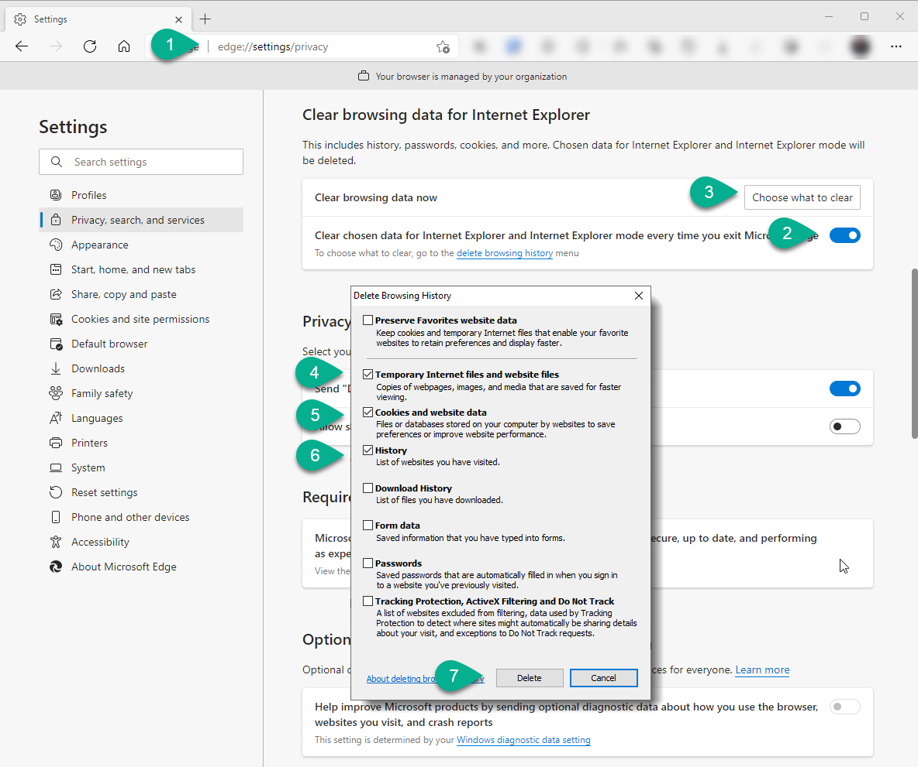
Privacy Settings
Type in URL/Address Bar edge://settings/privacy
Under the heading Clear browsing data for Internet Explorer select slider Clear chosen data for Internet Explorer and Internet Explorer mode every time you exit Microsoft Edge.
Select button Choose what to clear.
Select Temporary Internet files and website files, Cookies and website site data, History. – The application requires the most current page, if page data is left in your temporary internet files you may experience corrupted information.
Select Delete.

Slide 7
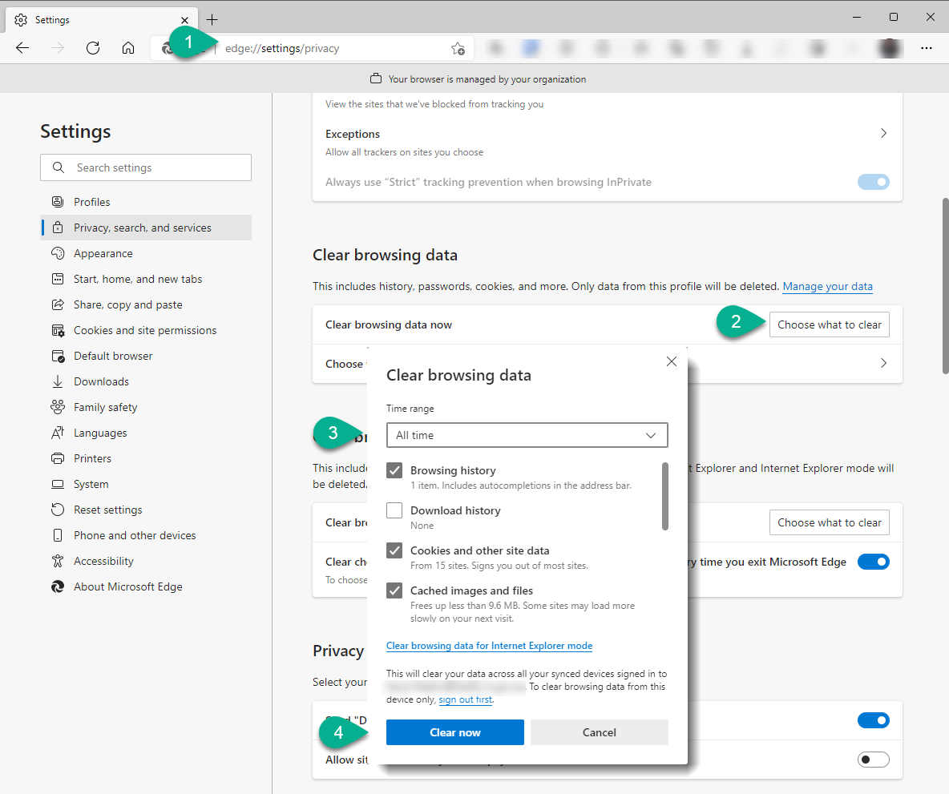
Privacy Settings Continued
Type in URL/Address Bar edge://settings/privacy
Under the heading Clear browsing data select button Choose what to clear.
Select Time range All time, check box: Browsing history – Cookies and other site data – Cached images and files. -The application requires the most current page, if page data is left in your temporary internet files you may experience corrupted information.
Select button Clear now

Slide 8
Appendix: Microsoft references
Edge Privacy Controls | Explained Here With Policy Details
Clear Cookies and other site data: Also to retain cookies on exit: | https://docs.microsoft.com/en-us/deployedge/microsoft-edge-policies#defaultcookiessetting https://docs.microsoft.com/en-us/deployedge/microsoft-edge-policies#savecookiesonexit
Cached images and files | https://docs.microsoft.com/en-us/deployedge/microsoft-edge-policies#clearcachedimagesandfilesonexit
Browsing history AND Download History | https://docs.microsoft.com/en-us/deployedge/microsoft-edge-policies#clearbrowsingdataonexit
Browser history | https://docs.microsoft.com/en-us/deployedge/microsoft-edge-policies#allowdeletingbrowserhistory
For kiosk deletion of downloads | https://docs.microsoft.com/en-us/deployedge/microsoft-edge-policies#kioskdeletedownloadsonexit
Clear Cookies and other site data: Also to retain cookies on exit: | https://docs.microsoft.com/en-us/deployedge/microsoft-edge-policies#defaultcookiessetting https://docs.microsoft.com/en-us/deployedge/microsoft-edge-policies#savecookiesonexit

